Slide 1
Comprehension Instructional Sequence (CIS) Workshop
Jodi Tillman, Public Schools Liaison
Division of Career and Adult Education
Florida Department of Education
Escambia County
August 14, 2013

Slide 2
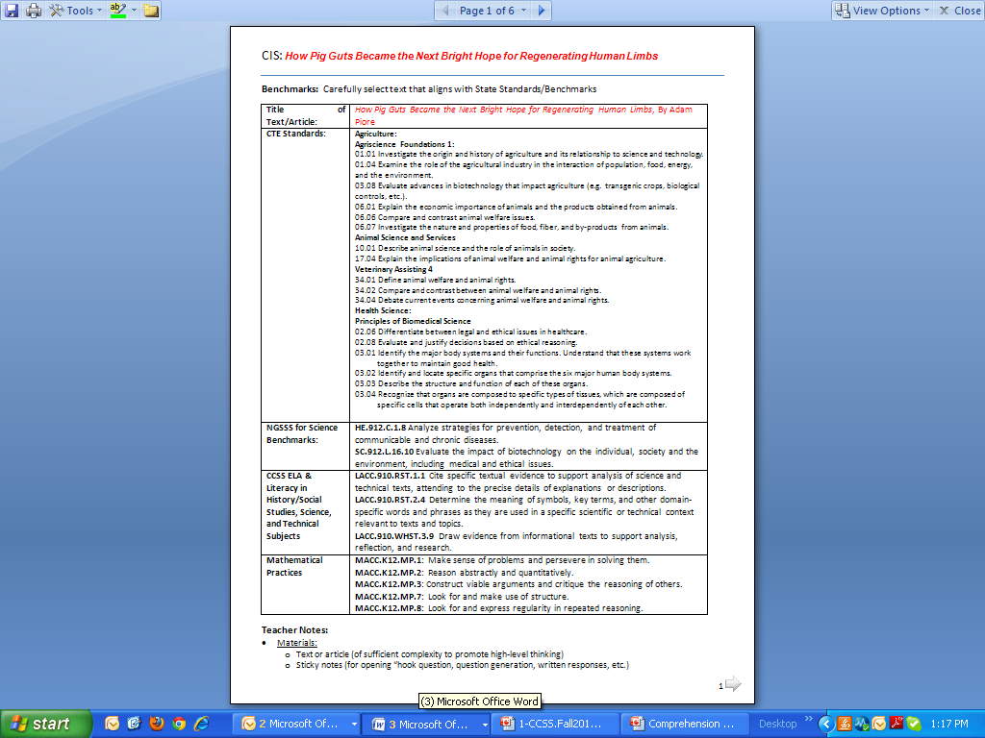

Slide 3
Activate Prior Knowledge!
Hook Question: What are ethics and why should ethics be considered when making decisions?
Predictive Written Response to Complex Text-Based Question: What are some positive and negative consequences of research in the field of biotechnology and medicine?
Handout
Handout
Notes:
Activate prior knowledge on the Comprehension Instructional Sequence (CIS).
Step #1 and Reading #1
1) Hook Question: Teacher asks hook question to launch opening discussion, reads aloud to students while students mark text, students read the text and participate in directed note-taking. Purpose: To bring world relevance to text reading, establish a purpose for reading, model fluent reading, provide opportunities for students to become interactive with the text, and think critically about information in the text.
2) Predictive Written Response:
3) Vocabulary Front-loading: Direct students to locate words introduced in the text by paragraph number.
4) Text-marking
A – this section of text shows an adaptation
L – this section of text shows a link in the sequence for the evolution of the adaptation
H – this section of text shows a scientific hypothesis
Model for students by reading the text aloud and coding a portion of the text. Students follow along and mark their copy. Students proceed to code the rest of the text independently. Students share text markings with table group or partner.
Directed Note-Taking and Reading #2
Record notes containing the most important information relevant to the guiding question

Slide 4
Ethics
Definition of ethics (n) eth·ics [ éthiks ]
study of morality's effect on conduct: the study of moral standards and how they affect conduct
code of morality: a system of moral principles governing the appropriate conduct for a person or group
Synonyms: morals, beliefs, moral code, moral principles, moral values, integrity, conscience, principles

Slide 5
Integrity
Definition of integrity (n): in·teg·ri·ty [ in téggrətee ]
possession of firm principles: the quality of possessing and steadfastly adhering to high moral principles or professional standards.
Conscience
Definition of conscience (n): con·science [ kónshənss ]
sense of right and wrong: the sense of what is right and wrong that governs somebody's thoughts and actions, urging him or her to do right rather than wrong

Slide 6
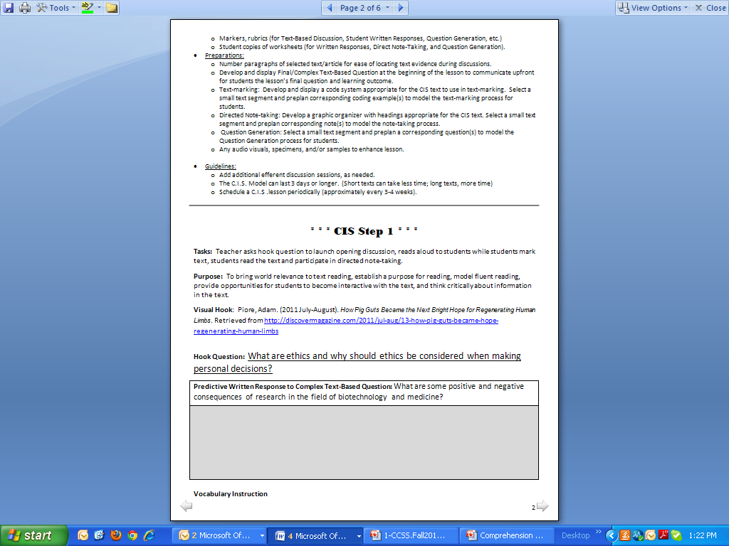

Slide 8
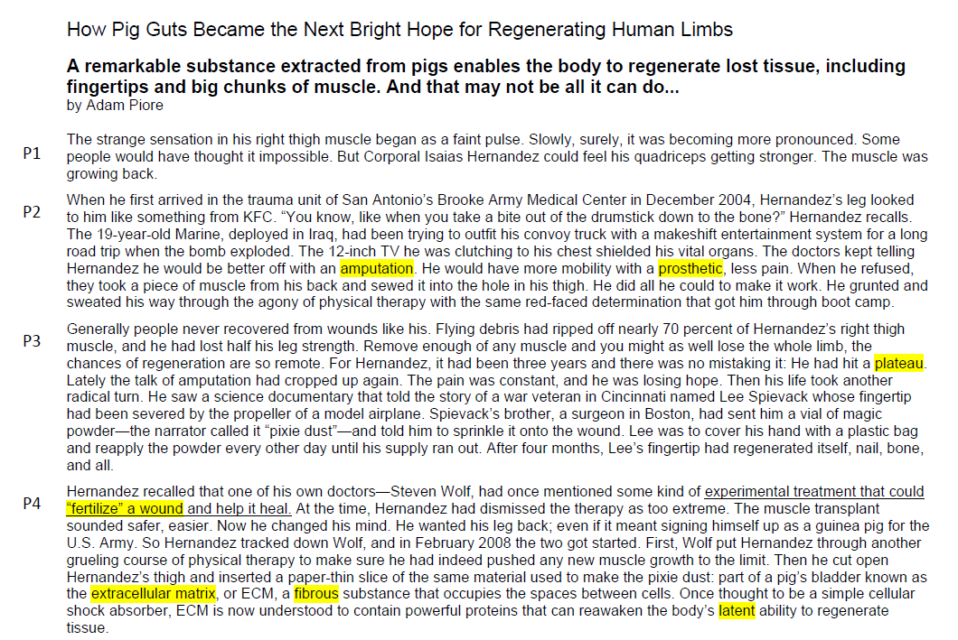
Vocabulary Front-loading
Independently, identify/highlight/underline words that are unfamiliar to you.
Notes:
Reading #1
Text-marking
P – this section of text shows a positive impact of biotechnology on society or the individual
N – this section of text shows a negative impact of biotechnology on society or the individual
D – this section of text shows a scientific discovery
Model for students by reading the text aloud and coding a portion of the text. Students follow along and mark their copy. Students proceed to code the rest of the text independently.
After text marking:
In small groups, compare and discuss differences in text coding.
Support your suggested answers from the text.

Slide 9
Vocabulary Front-loading
Para-graph # | Academic or Discipline Specific Vocabulary | Word Part or Context | Para-graph # | Academic or Discipline Specific Vocabulary | Word Part or Context
2 | Amputation Amp- means “by shortening” -ation forms a noun | Word Part | 5 | Latent “…proteins that can reawaken the body’s latent ability to regenerate tissue.” | Context
2 | Prosthetic Pros- means “toward or near” -thetic from the root thet meaning "placed, set" | Word Part | 7 | Virulent Vir- means “poison” -ulent means “having in quantity” | Word part
3 | Plateau “Three years and there was no mistaking it: He had hit a plateau.” | Context | 9 | Manipulations Manu- means “hand” -ations turns word into noun | Word part
4 | Extracellular matrix Extra- means “outside or beyond” | Word Part | 9 | Strictures Strict- means “tightening” Abnormal contractions/tightening | Word part
4 | experimental treatment that could “fertilize” a wound and help it heal. | Context | 10 | Lymphoma -oma suffix used for names of tumors | Word part
4 | Fibrous - ous means full of or possessing | Word Part | 10 | Cardiomyoplasty Cardio- means “heart” -myo- means “muscle” -plasty means “formation” | Word part
Vocabulary Instruction
Direct students to locate words introduced in the text by paragraph number.
Model for students how to derive word meaning(s) from word parts (prefix, root, suffix) and/or context.
Record meanings of word parts and words on word wall, journal, etc.
Notes:
Direct students to locate words introduced in the text by paragraph number.
Model for students how to derive word meaning(s) from word parts (prefix, root, suffix) and/or context. Record meanings of word parts and words on chart paper.
Variations for Vocabulary Instruction:
record meanings of word parts and words in word study guide, journal writing, graphic organizers, etc.
post word parts, words, and their meanings on a vocabulary word wall; refer to word wall during reading, discussions, and writing throughout CIS lesson and subsequent lessons.

Slide 10
Text Marking (Reading #1):
An active reading strategy that helps students focus and isolate essential information in a text, improving their comprehension and retention of reading material.
P – this section of text shows a positive impact of biotechnology on society or the individual
N – this section of text shows a negative impact of biotechnology on society or the individual
D – this section of text shows a scientific discovery
E- this section deal with an ethical issue

Slide 11
Text Marking
P – this section of text shows a positive impact of biotechnology on society or the individual
N – this section of text shows a negative impact of biotechnology on society or the individual
D – this section of text shows a scientific discovery
E – this section of text shows an ethical issue
P
P
N
D
D
E
D
P
Notes:
Reading #1
Text-marking
P – this section of text shows a positive impact of biotechnology on society or the individual
N – this section of text shows a negative impact of biotechnology on society or the individual
D – this section of text shows a scientific discovery
Model for students by reading the text aloud and coding a portion of the text. Students follow along and mark their copy. Students proceed to code the rest of the text independently.
After text marking:
In small groups, compare and discuss differences in text coding.
Support your suggested answers from the text.

Slide 12
Directed Note-Taking
Handout
Present a guiding question to direct students thinking while taking notes. Teacher models note-taking using an example statement from the text, then selecting the category or categories that support the statement. Students complete note-taking collaboratively or independently.
Directed Note Taking: How Pig Guts Became the Next Bright Hope for Regenerating Human Limbs
Guiding Question: Using evidence from the article, how has biotechnology had positive and negative impacts on society and individuals?
Paragraph # | NOTES | Check relevant categories below
 |  | + Impact BioTech on Society or Individual | - Impact BioTech on Society or Individual | Ethical issues | New discovery
2 | he would be better off with an amputation…
3 | …a vial of magic powder and sprinkle it onto the wound. After four months, Lee’s fingertip had regenerated itself, nail, bone, and all.
4 | Hernandez recalled that one of his own doctors—Steven Wolf, had once mentioned some kind of experimental treatment that could “fertilize” a wound and help it heal.
X
X
In small groups, based on the information from the article and your notes, take positions and discuss which factors has had the most significant impact on society and/or individuals. Use the text to justify all positions.
Come to consensus on which category is the most impactful according to the text.
X
X
X
X
Notes:
Directed Note-Taking and Reading #2
Record notes containing the most important information relevant to the guiding question.
Present a guiding question to direct students thinking while taking notes. Teacher models note-taking using an example statement from the text, then selecting the category or categories that support the statement. Students complete note-taking collaboratively or independently.
Conduct small- and whole-group efferent discussion. Based on the information from the article and your notes, take positions and discuss which of the following factors has had the most significant impact on society and/or individuals. Use the text to justify all positions.
First Draft Written Response to Essential Question
Ask students to complete the second Written Response.
Variations for this Written Response: Sticky notes quick writes, collaborative partners, written conversations

Slide 13
Directed Note-Taking
Handout
First Draft Written Response to Essential Question Using evidence from the text, why is it important to consider positive and negative impacts on society, including ethics, in scientific research prior to conducting scientific research?
Notes:
Directed Note-Taking and Reading #2
Record notes containing the most important information relevant to the guiding question
Present a guiding question to direct students thinking while taking notes. Teacher models note-taking using an example statement from the text, then selecting the category or categories that support the statement. Students complete note-taking collaboratively or independently.
Conduct small- and whole-group efferent discussion. Ask groups to come to consensus on which category is the most impactful according to the support from the text.
First Draft Written Response to Essential Question
Ask students to complete the second Written Response.
Variations for this Written Response: Sticky notes quick writes, collaborative partners, written conversations

Slide 14
Question Generation
Purpose: To provide students with a demonstration of question generation and the opportunity for them to interact with the text by generating questions to further deepen their comprehension.
Question Generation: How Pig Guts Became the Next Bright Hope for Regenerating Human Limbs
Para- graph # | Questions | Check relevant categories below
 |  | + Impact Biotech on Society or Individual | - Impact Biotech on Society or Individual | Ethical issues | Future Research
2 | Why did the doctors use a piece of muscle from the back? Why did it not work? What negative impact would this have on the individual? |  | X
3 | What was the purpose of covering the hand with a plastic bag? |  |  |  | X
Generate questions unanswered from your first text reading. Record your questions on your Student Question Generation paper as you work in pairs or small groups. In your groups, select one question and place on grid at front of room in appropriate category.
Notes:
Teacher models re-reading a portion of the text and generates one or two questions.
Students continue to review/scan the text and use their recorded notes to generate questions about information in the text collaboratively or independently.
To conclude question generation, the teacher has students:
share their questions with the related category whole class and discuss which questions they have in common, and which questions are most relevant or significant to their learning.
record/post common and relevant/significant questions to encourage:
extended efferent text discussion
students to seek/locate answers in text-reading throughout the remainder of the chapter/unit focusing on unanswered questions in collaborative inquiry.

Slide 15
Take positions, discuss which factor is most significant/impactful, and come to consensus.
 | Group Consensus | Individual Vote #1 | Individual Vote #2
Positive Impact
Negative Impact
Ethical Issue
Discovery
Count number of groups that selected each category.
Count number of individuals that selected each category.
3) After hearing discussion and text-based evidence, did you change your mind? New independent vote! (Modification - Four Corners)

Slide 16
Final Response After Rereading and Extended Text Discussion
Purpose: To provide opportunities for students to interact with the text and with their peers to:
identify text information most significant to the final/essential question.
facilitate complex thinking and deep comprehension of text.
After the final discussion, answer the following question on your handout:
According to the text and extended text discussion, which factor is most likely the primary concern for scientists when conducting scientific research?
How does ethics play a role in scientific research?

Slide 17
Comprehension Instructional Sequence (CIS)
Facilitates students…
Using background knowledge, i.e., predicting, inferring
Identifying key ideas from text
Learning and using text structures
Monitoring comprehension and employing fix-up strategies
Using a variety of reading strategies effectively
Paraphrasing, explaining, and summarizing information to construct conclusions
Engaging in question generation
Extended text discussion and writing

Slide 18
Get Into Groups By Cluster
As a group, create a CIS lesson using the article – Women Make Little Progress Atop Fortune 500 in 2012
Share out created sections with your group (peer teach sections)
Create a poster from your group’s work – share out (gallery walk)

Slide 19
Select an article appropriate for your cluster area
As a group, select an article (may pick several articles for “big” clusters)
Share out created sections to the whole group (peer teach sections)
Report out to group as whole

Slide 20
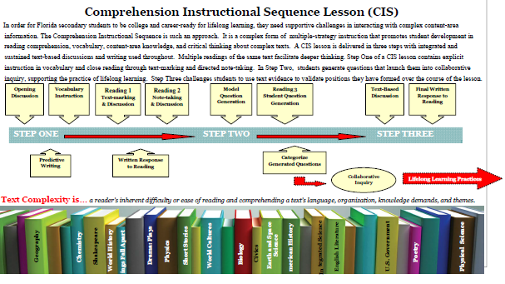
CIS Brochure from Just Read, Florida!

Slide 21
Get trained…
CIS ☑
NGCARPD – district training
CC CATER – in the spring of 2014

Slide 22
Contact Information
Jodi Tillman
Jodi.tillman@fldoe.org
850-245-9439

